Slide 1

Hmonics Iteration 2
All Day Every Day
Cheng | Derick | Jared | Philip
Notes:
Jared

Slide 2
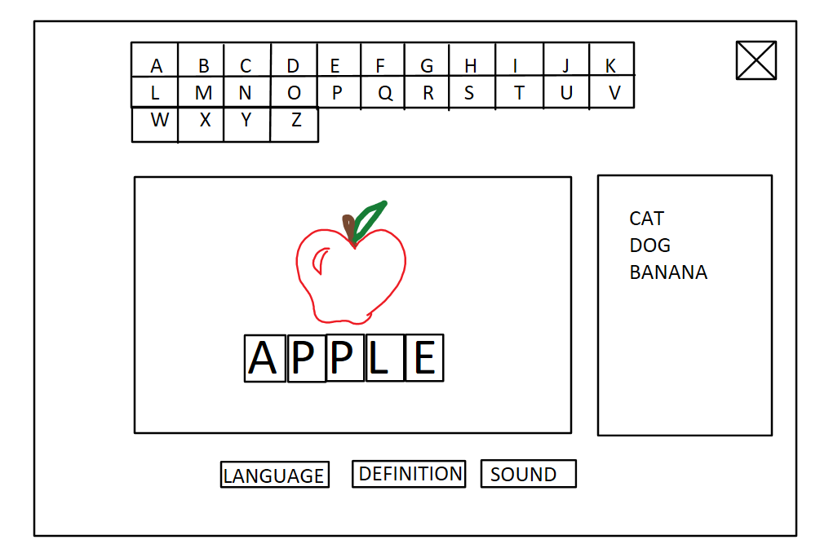

Recap
Phonics game for kindergarten-aged students
Helps students learn to speak and spell the Hmong language
Fun for kids, but not too fun – education is key, gamification can be detrimental
Provides feedback in the form of customized reports
Notes:
Provide a brief recap of your project and your team.

Slide 3

Key Features
Students learn how to spell and say simple words in the Hmong language.
Playing a game makes the intricacies of English to Hmong easier to understand.
Rewarding animations keep children interested.
Uses a drag and drop interface for easy learning.
Students can see their progress of how many words they have spelled.
Teachers can create profiles for their students.
Teachers can view a report of each student’s progress.
System is available on both popular mobile platforms.
Notes:
Jared

Slide 4
Use Case Diagram
Notes:
Present your use case diagram and call out the architecturally significant use cases and non-functional requirements. Provide a rationale for your decision

Slide 5
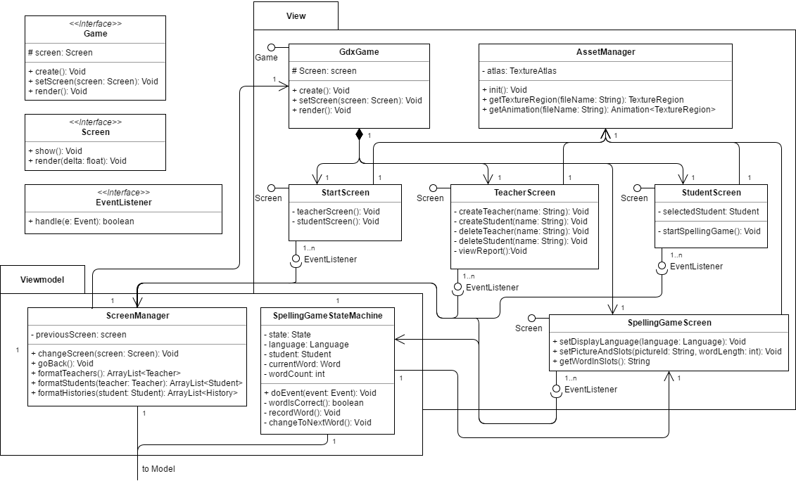
Notes:
Present your class diagram

Slide 6
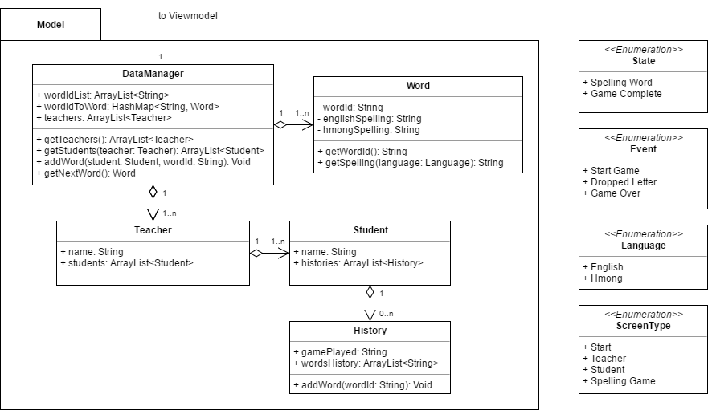

Slide 7
Notes:
Present the sequence diagrams for the architecturally significant use cases.

Slide 12
Technical / Non-Technical Challenges
Communication can be difficult as students
Framework has a learning curve
Framework pretty much requires IntelliJ as IDE
Notes:
Provide a summary of any technical and non-technical challenges you have or are facing and how you are dealing with them.

Slide 13
DEMO!
Notes:
Demo of working code
Plan on 15-20 minutes with a follow-up Q&A.

